Slide 1
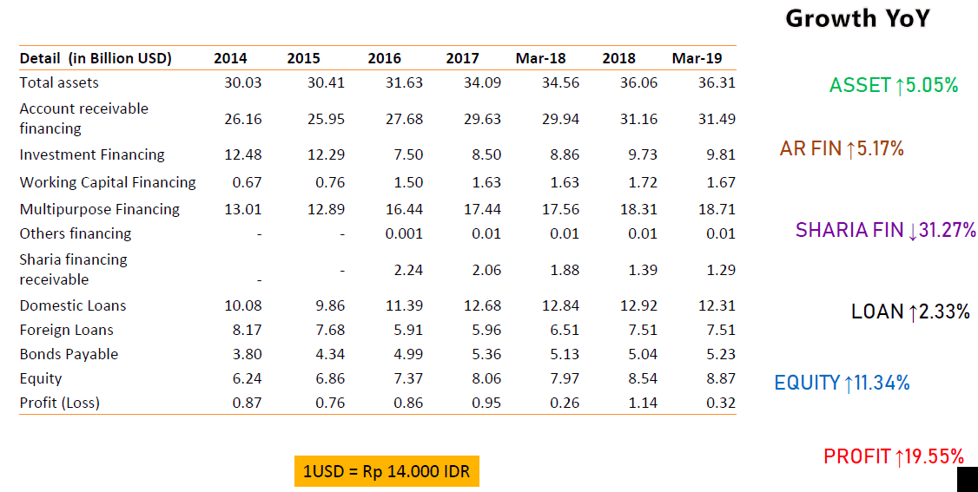
Multi-finance Growth

Slide 2
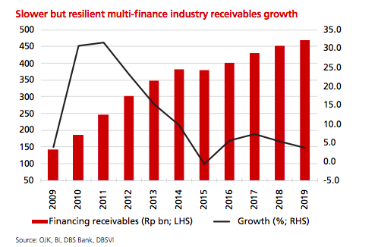
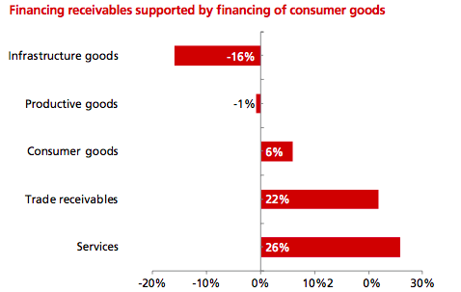
Multi-finance Growth

Slide 3
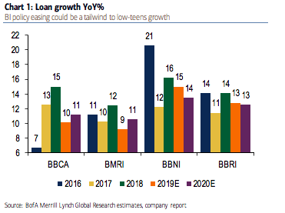
Multi-finance Growth - Banks

Slide 4
Multi-finance Key Metrics
Notes:
Source: OJK

Slide 5
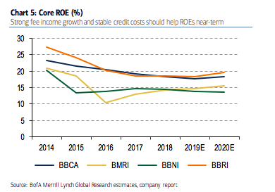
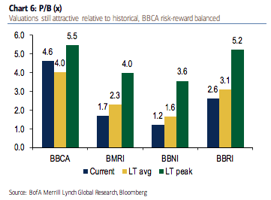
Multi-finance Key Metrics - Banks

Slide 6
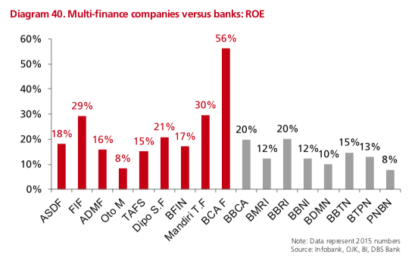
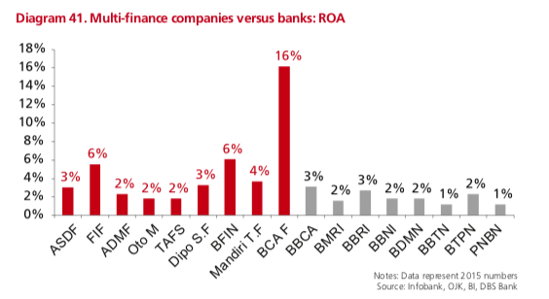
Multi-finance Key Metrics – ROE/ROA in comparison

Slide 7
Multi-finance Key Metrics – Banks
Notes:
Source: World Bank

Slide 8
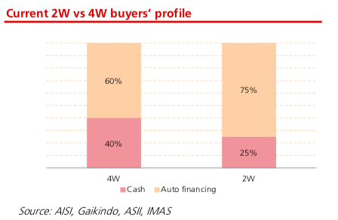
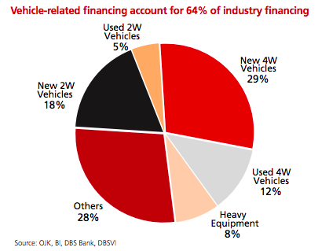
Multi-finance Driver – Vehicle Sales
Notes:
Source: AISI, gaikindo

Slide 9
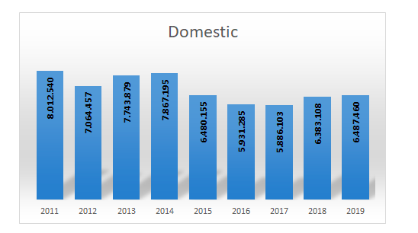
Multi-finance Driver – 4W & 2W Sales
2W Sales
4W and 2W sales have been mostly flat in recent years
Notes:
Source: AISI, gaikindo

Slide 10
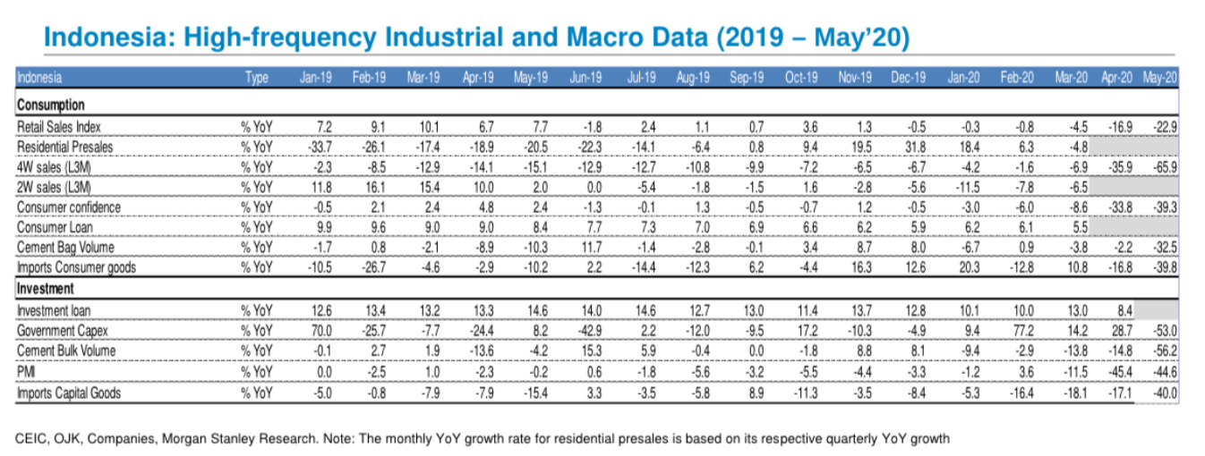
Multi-finance Driver (Cont’d) – 4W sales being heavily impacted by covid in ‘20

Slide 11
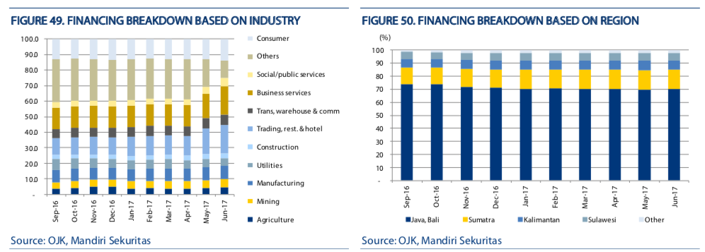
Multi-finance Driver – Industry and region

Slide 12
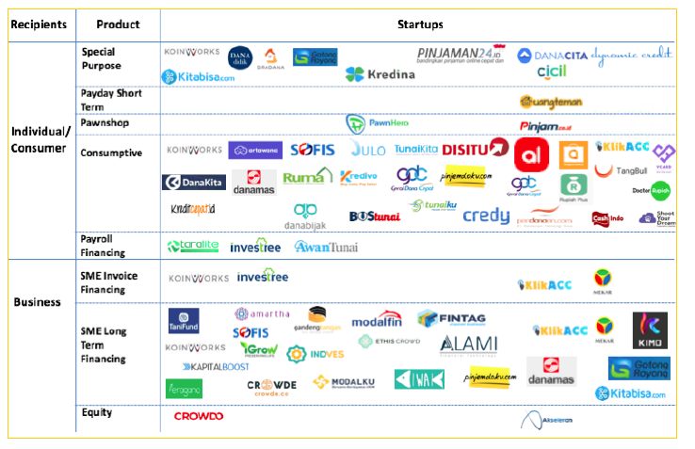
Multi-finance Digital lending/P2P landscape

Slide 13
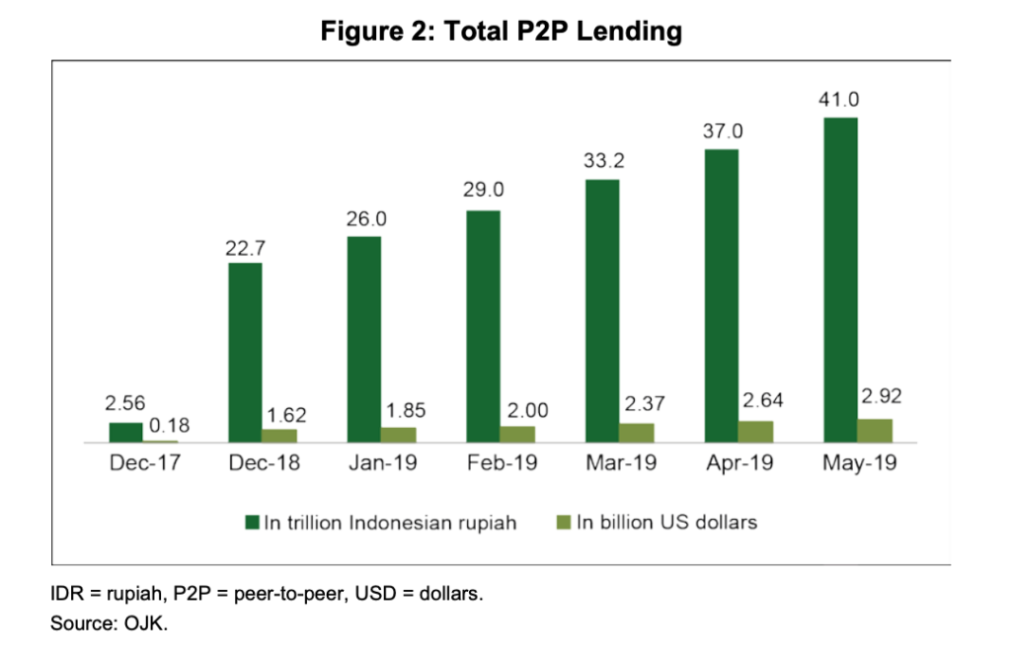
Multi-finance Digital lending/P2P is growing fast in Indo

Slide 14
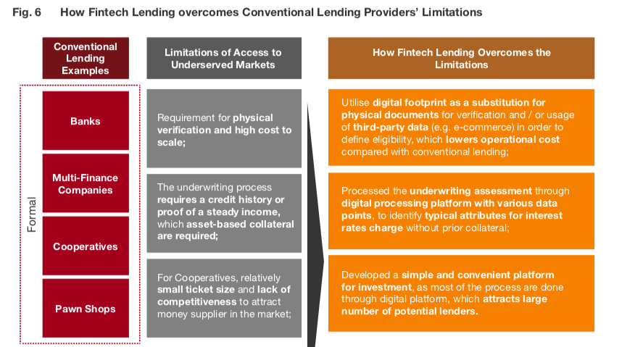
Multi-finance How fintech lending overcomes Multi-finance limitation
Notes:
Source: PwC
https://www.thejakartapost.com/news/2017/03/03/do-fintech-companies-threaten-multi-finance-firms.html

Slide 15
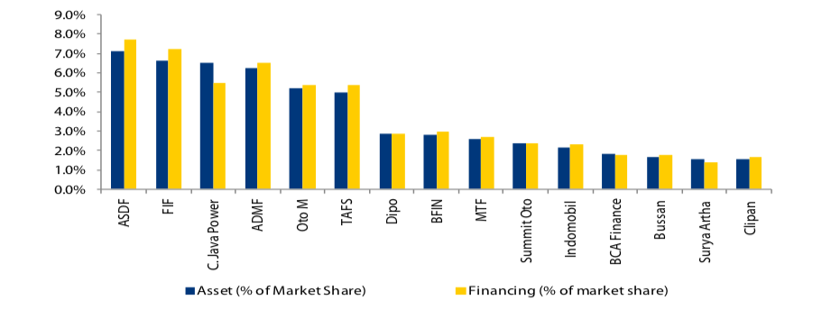
Multi-finance Fragmented Markets

Slide 16
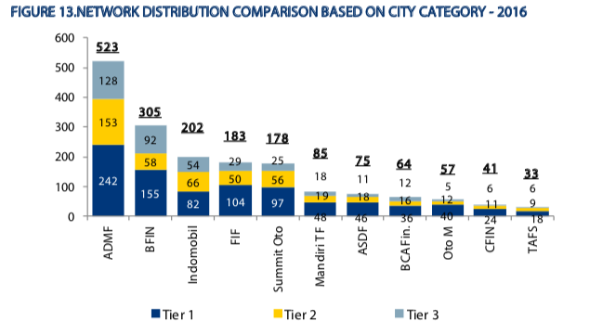
Multi-finance Network distribution

Slide 17
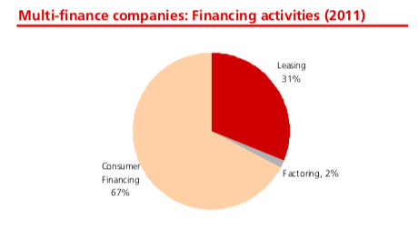
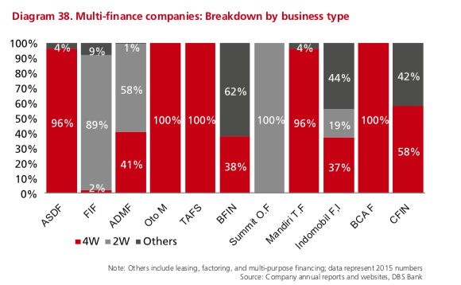
Multi-finance Industry Sub-segment
Thinking a better way of expressing this

Slide 18
Multi-finance Company Screening
 | Mandala Multifinance (MFIN) | Batavia Prosperindo Finance (BPFI) | Indomobil Multi Jasa (IMJS) | Danasupra Erapacific (DEFI)
Mrkt Cap (US m) | 176.8 | 146.1 | 100.5 | 85.5
Rev | 98.2 | 19.5 | 270.2 | 1.1
Net Income | 27.1 | 5.0 | 3.0 | 0.9
Rev CAGR (5y) | 3.4% | 16.4% | 16.4% | 40.2%
Shareholding | Non-SOE | Non-SOE | Non-SOE | Non-SOE
Interest cost rate | 11% | 38% | 6% | n.a.
Revenue Exposure | Consumer Financing 100% | Consumer Financing: 58%, Finance Lease: 11%, Factoring:4%, Unallocated:27% | Car Rental:46%, Other Financial Services: 54% | Consumer Financing: 7%, Factoring:19%, Unallocated:74%
Network (# of branches) | 273 | 71 | n.a. | 66
Comments |  | Owned by Batavia Prosperindo Internasional (Asset manager)

Slide 19
Multi-finance Company Screening
 | Clipan Finance (CFIN) | Wahana Ottomitra Multiarha (WOMF) | Buana Finance (BBLD) | Verena Multi Finance (VRNA)
Mrkt Cap (US m) | 54.3 | 49.1 | 44.8 | 43.6
Rev | 95.7 | 93.2 | 21.4 | 9.9
Net Income | 25.9 | 18.0 | 4.0 | 2.1
Rev CAGR (5y) | 19.1% | 16.5% | 8.1% | 8.3%
Shareholding | Non-SOE | Non-SOE | Non-SOE | Non-SOE
Interest cost rate | 36% | n.a. | 51% | 56%
Revenue Exposure | Consumer Financing: 74%, Finance Lease: 8%, Factoring:1%, Unallocated:17% | Consumer Financing: 100% | Consumer Financing: 75%, Finance Lease: 24%, Unallocated:1% | Consumer Financing: 51%, Finance Lease: 41%, Admin:8%
Network (# of branches) | 45 | 129 | 36 | 20
Comments | Owned by bank Pan Indonesia | Owned by Maybank |  | Owned by Mizuho Leasing Company/ Bank Pan Indonesia

Slide 20
Multi-finance Regulations
OJK relaxes minimum down-payment for multi-finance companies with net NPF ≤1%
Effective December 2018
This provides flexibility for financially sound multi-finance companies with good credit processes and asset quality to grow faster.
This regulation also allows multi-finance companies to do multi-purpose cash lending. They can now provide consumer cash loans and working capital cash loans.
However, certain restrictions apply – such as ceiling of Rp500m for loans and collateral requirements (e.g. vehicle, land, building, heavy equipment).

